Slide 1
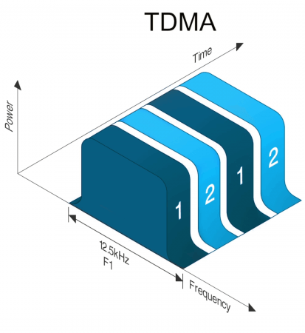

Slide 2
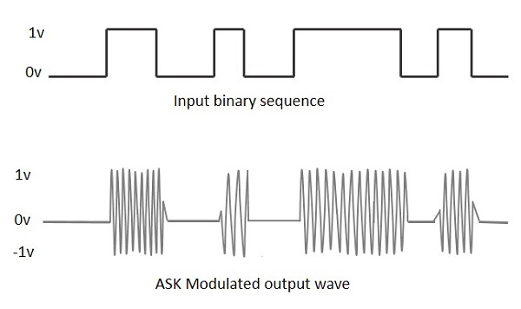

Slide 3
+1
Digital Input
Multiplier
BPSK
-1
Carrier

